Slide 1

Review for 0713 class
Wun-Yu(Alyce)
2022/07/14

Slide 2
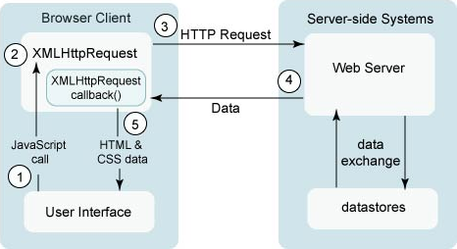
AJAX
AJAX = Asynchronous JavaScript And XML.
AJAX is not a programming language. A way of using JS.
AJAX allows web pages to be updated asynchronously by exchanging data with a web server behind the scenes. This means that it is possible to update parts of a web page, without reloading the whole page. → A way to download data from a server without reloading your page.

Slide 3
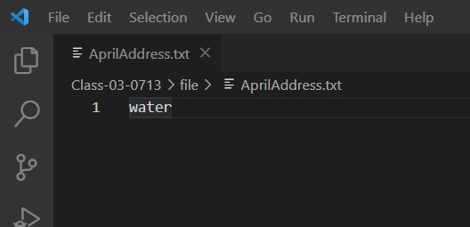
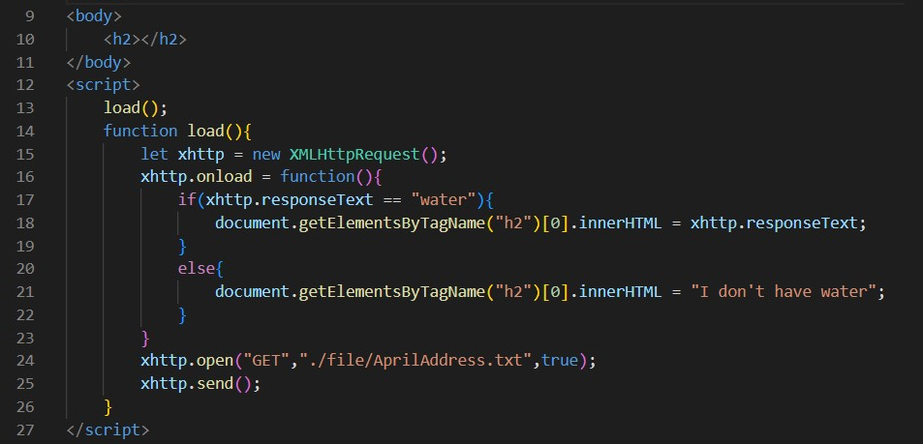
How does XMLHttpRequest work?

Slide 4
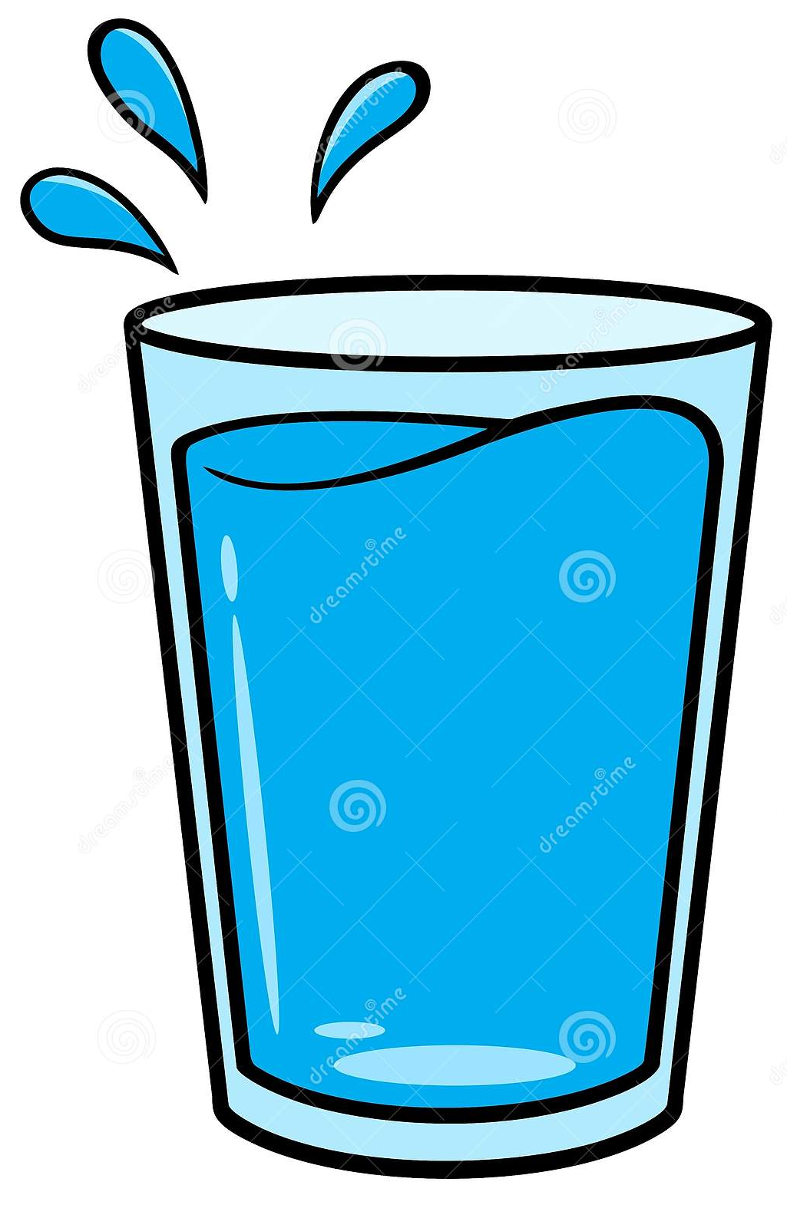


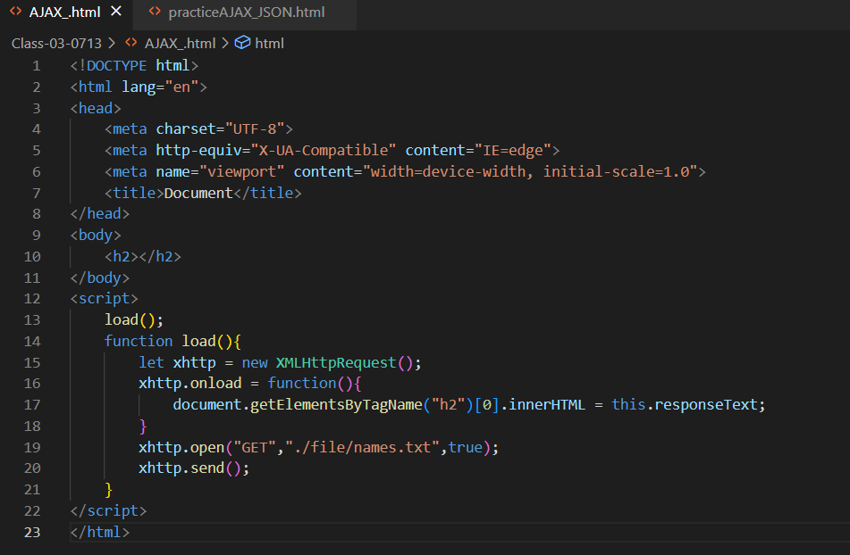
How does XMLHttpRequest work?
I need some water.
I’m gonna request from April.
April
1. Create an XMLHttpRequest object
Lin-Wen

Slide 5


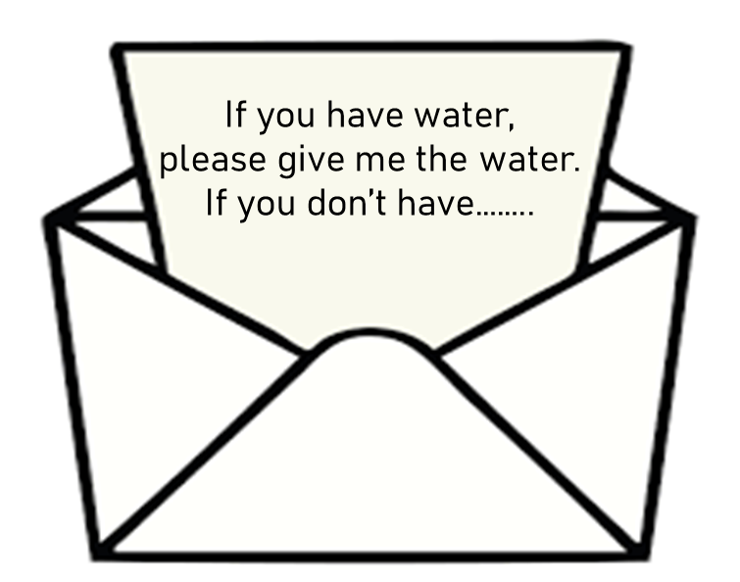
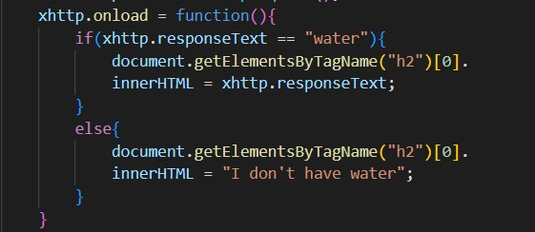
How does XMLHttpRequest work?
2. Define a callback function
Lin-Wen

Slide 6

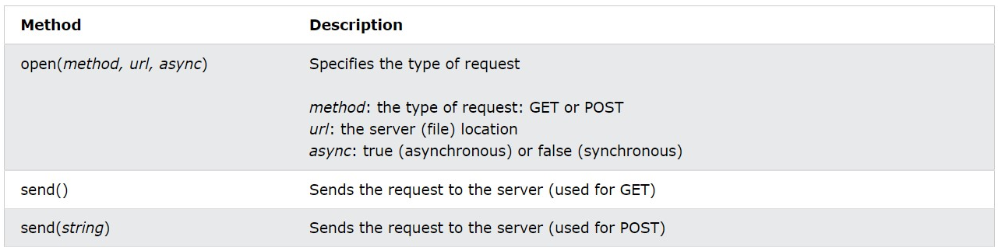

How does XMLHttpRequest work?
3. Open the XMLHttpRequest object
Lin-Wen

Slide 7
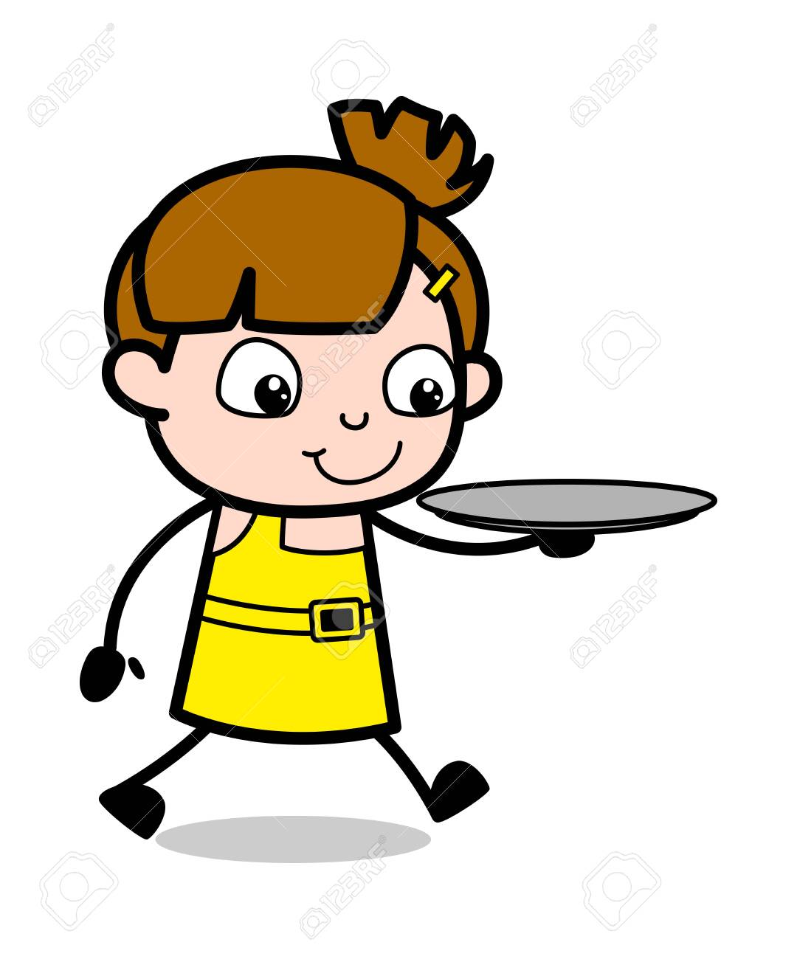

How does XMLHttpRequest work?
Sever
4. Send a Request to a server
April
Lin-Wen

Slide 8

Work of XMLHttpRequest object
Create an XMLHttpRequest object → new XMLHttpRequst()
Define a callback function → onload()
Open the XMLHttpRequest object → open()
Send a Request to a server → send()
1
2
Lin-Wen
3
4

Slide 9
Synchronous vs. Asynchronous

Slide 10

What is synchronous/asynchronous?
What did you say?

Slide 11
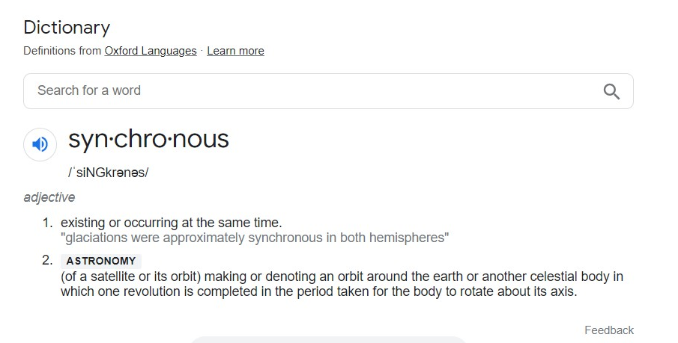
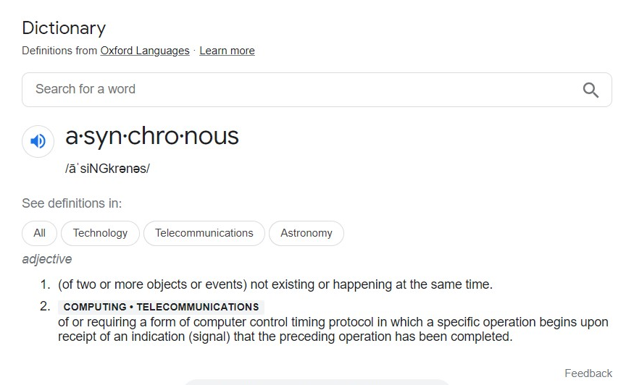
Definition in dictionary

Slide 12
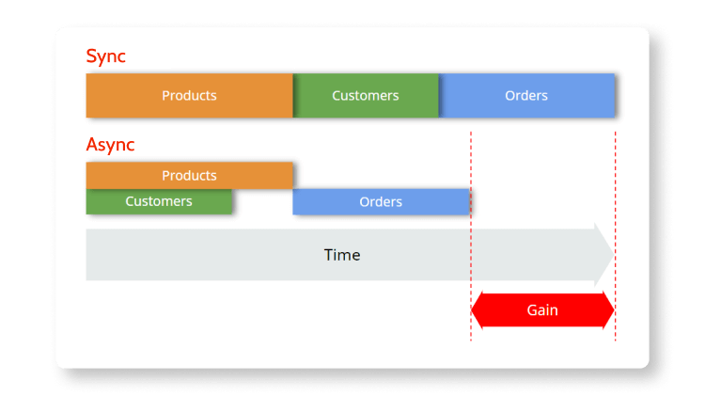
Definition in JavaScript
In synchronous operations tasks are performed one at a time and only when one is completed, the following is unblocked. In other words, you need to wait for a task to finish to move to the next one.
In asynchronous operations, on the other hand, you can move to another task before the previous one finishes. This way, with asynchronous programming you’re able to deal with multiple requests simultaneously, thus completing more tasks in a much shorter period of time.

Slide 13
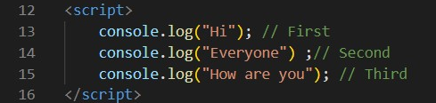
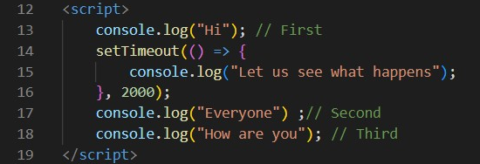
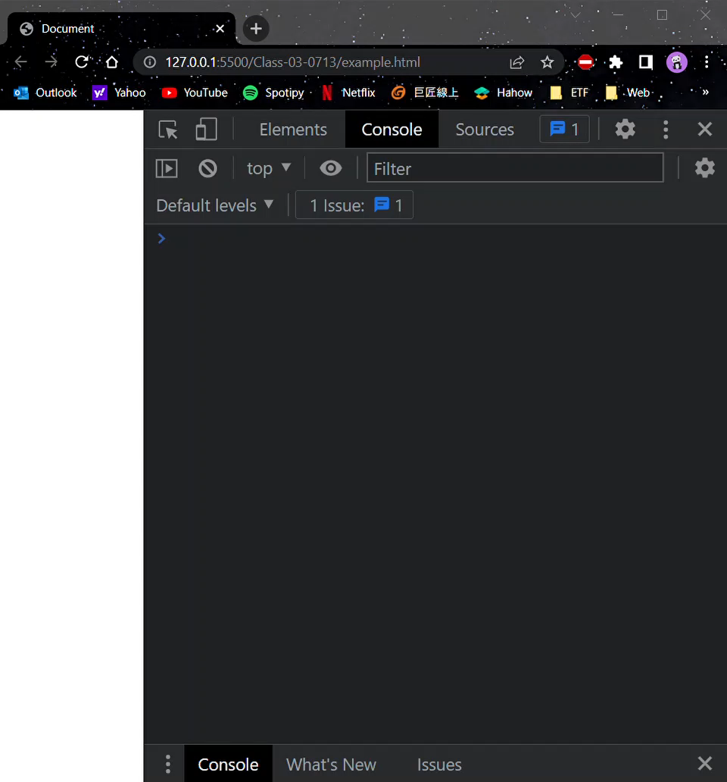

Asynchronous
Synchronous

Slide 14
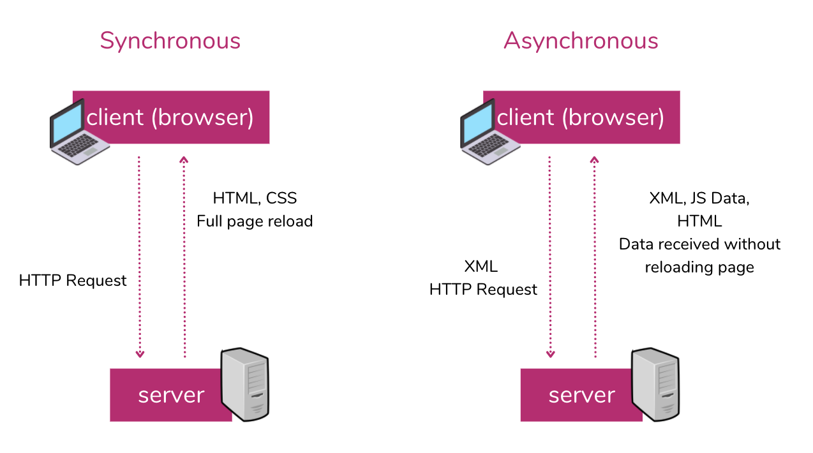
https://developer.mozilla.org/en-US/docs/Learn/JavaScript/Asynchronous/Introducing

Slide 15

Is Vue/React synchronous or asynchronous?

Slide 16
Reference
https://www.w3schools.com/js/js_ajax_intro.asp
https://courses.cs.washington.edu/courses/cse190m/07sp/lectures/slides/09-ajax.html
https://www.outsystems.com/blog/posts/asynchronous-vs-synchronous-programming/
https://www.geeksforgeeks.org/synchronous-and-asynchronous-in-javascript/

